Slide 1
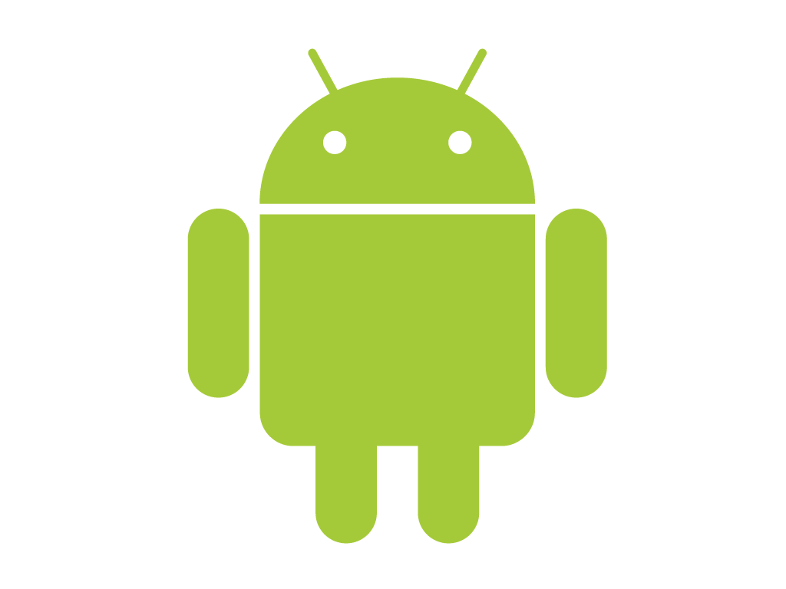
Android OS
Architecture
Presented by:-
Name – Angshuman Halder
Dept. – CSE
Univ. Roll – 11900113008

Slide 2
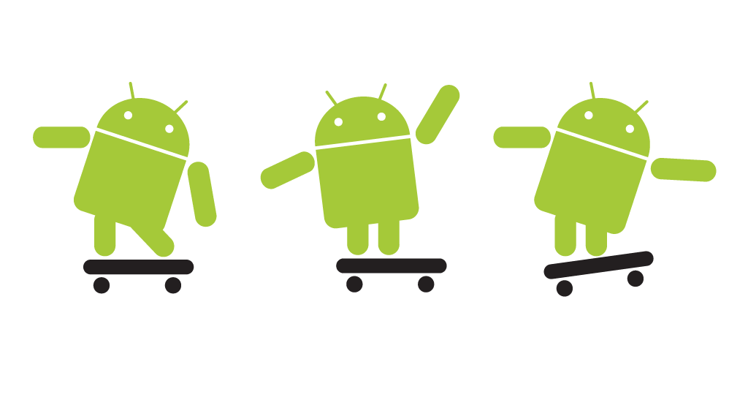
Software platform from Google and the Open Handset Alliance
July 2005, Google acquired Android, Inc.
November 2007, Open Handset Alliance formed to develop open standards for mobile devices
October 2008, Android available as open source
December 2008, 14 new members joined Android project
Introduction to Android
A brief History to Android Origin
Notes:
Android is the software platform from Google and the Open Handset Alliance that some say has the potential to revolutionize the global cell phone market.
Android is a software environment built for mobile devices. It is not a hardware platform. While components of the underlying OS
are written in C or C++, user applications are built for Android in Java.
In July 2005, Google acquired Android, Inc., a small startup company based in Palo Alto, CA. 4 of Android's co-founders went to work at Google.
At Google, the team developed a mobile device platform powered by the Linux kernel which they marketed to handset makers and carriers on the premise of providing a flexible, upgradeable system.
On 5 November 2007, the Open Handset Alliance, a consortium of several companies including Texas Instruments, Google, Intel, Motorola, and Sprint Nextel (just to name a few) announced the goal to develop open standards for mobile devices and unveiled their first product, Android, a mobile device platform built on the Linux kernel.
Open Handset Alliance is an alliance of approximately 30 organizations committed to bringing a “better” and “open” mobile phone to market. A quote taken from its website says it best: “Android was built from the ground up with the explicit goal to be the first open, complete, and free platform created specifically for mobile devices.”
Android has been available as open source since October 2008. Google opened the entire source code under an Apache License.
With the Apache License, vendors are free to add proprietary extensions without submitting those back to the open source community.
On 9 December 2008, 14 new members joined the Android project including Garmin, Sony Ericsson, Toshiba, and Vodafone Group.

Slide 3
The android architecture consists of 4 layers
Linux Kernel Layer
Libraries And Runtime Environment Layer
Application Framework Layer
Application Layer
Android Architecture
Notes:
Applications
Android will ship with a set of core applications including an email client, SMS program, calendar, maps, browser, contacts, and others. All applications are written using the Java programming language.
Application Framework
By providing an open development platform, Android offers developers the ability to build extremely rich and innovative applications. Developers are free to take advantage of the device hardware, access location information, run background services, set alarms, add notifications to the status bar, and much, much more.
Developers have full access to the same framework APIs used by the core applications. The application architecture is designed to simplify the reuse of components; any application can publish its capabilities and any other application may then make use of those capabilities (subject to security constraints enforced by the framework). This same mechanism allows components to be replaced by the user.
Underlying all applications is a set of services and systems, including:
A rich and extensible set of that can be used to build an application, including lists, grids, text boxes, buttons, and even an embeddable web browser
that enable applications to access data from other applications (such as Contacts), or to share their own data
A Resource Manager, providing access to non-code resources such as localized strings, graphics, and layout files
A Notification Manager that enables all applications to display custom alerts in the status bar
An Activity Manager that manages the lifecycle of applications and provides a common navigation backstack
Libraries
Android includes a set of C/C++ libraries used by various components of the Android system. These capabilities are exposed to developers through the Android application framework. Some of the core libraries are listed below:
System C library - a BSD-derived implementation of the standard C system library (libc), tuned for embedded Linux-based devices
Media Libraries - based on PacketVideo's OpenCORE; the libraries support playback and recording of many popular audio and video formats, as well as static image files, including MPEG4, H.264, MP3, AAC, AMR, JPG, and PNG
Surface Manager - manages access to the display subsystem and seamlessly composites 2D and 3D graphic layers from multiple applications
LibWebCore - a modern web browser engine which powers both the Android browser and an embeddable web view
SGL - the underlying 2D graphics engine
3D libraries - an implementation based on OpenGL ES 1.0 APIs; the libraries use either hardware 3D acceleration (where available) or the included, highly optimized 3D software rasterizer
FreeType - bitmap and vector font rendering
SQLite - a powerful and lightweight relational database engine available to all applications
Android Runtime
Android includes a set of core libraries that provides most of the functionality available in the core libraries of the Java programming language.
Every Android application runs in its own process, with its own instance of the Dalvik virtual machine. Dalvik has been written so that a device can run multiple VMs efficiently. The Dalvik VM executes files in the Dalvik Executable (.dex) format which is optimized for minimal memory footprint. The VM is register-based, and runs classes compiled by a Java language compiler that have been transformed into the .dex format by the included "dx" tool.
The Dalvik VM relies on the Linux kernel for underlying functionality such as threading and low-level memory management.
Linux Kernel
Android relies on Linux version 2.6 for core system services such as security, memory management, process management, network stack, and driver model. The kernel also acts as an abstraction layer between the hardware and the rest of the software stack.

Slide 4


Slide 5
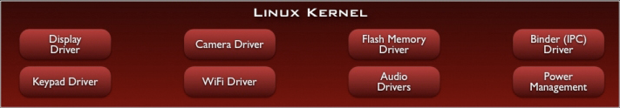
The Linux Kernel in Android Operating System is responsible for helping the installed native and Third party applications to communicate with the hardware. It also manages system resources such As Ram, Camera, Wifi And GPS, Proximity Sensor And Communicate With External Devices like Memory Cards, Keyboards, etc. The Linux Kernel keeps track of the application installed by assigning the with unique ID.
Linux Kernel
Notes:
This page provides data about the relative number of active devices running a given version of the Android platform. This can help you understand the landscape of device distribution and decide how to prioritize the development of your application features for the devices currently in the hands of users.
Data collected during two weeks ending on 1/4/2010

Slide 6
Android Version | API Level | Linux Kernel In AOSP
1.5 CUPCAKE | 3 | 2.6.27
1.6 DONUT | 4 | 2.6.29
2.0/1 ECLAIR | 5-7 | 2.6.29
2.2.X FROYO | 8 | 2.6.32
2.3.X GINGERBREAD | 9, 10 | 2.6.35
3.X.X HONEYCOMB | 11-13 | 2.6.36
4.0.X ICE CREAM SAN | 14, 15 | 3.0.1
4.1.X JELLYBEAN | 16 | 3.0.31
4.2.X JELLYBEAN | 17 | 3.4.0
4.3 JELLYBEAN | 18 | 3.4.39
4.4 KITKAT | 19, 20 | 3.10
5.X LOLLIPOP | 21, 22 | 3.16.1
6.0 MARSHMALLOW | 23 | 3.18.10
Linux Kernel
Notes:
This page provides data about the relative number of active devices running a given version of the Android platform. This can help you understand the landscape of device distribution and decide how to prioritize the development of your application features for the devices currently in the hands of users.
Data collected during two weeks ending on 1/4/2010

Slide 7
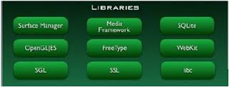
Android has it's own libraries, which is written in C/C++. These libraries cannot be accessed directly. With the help of application framework we can access these libraries. There are many libraries to access web browser, libraries for video formats, libraries for database etc.
Android Libraries
Notes:
Android applications are written in the Java programming language.
The compiled Java code — along with any data and resource files required by the application — is bundled by the Android Asset Packaging Tool into an Android package, an archive file marked by an .apk suffix. This file is the vehicle for distributing the application and installing it on mobile devices; it's the file users download to their devices. All the code in a single .apk file is considered to be one application.
In many ways, each Android application lives in its own world:
By default, every application runs in its own Linux process. Android starts the process when any of the application's code needs to be executed, and shuts down the process when it's no longer needed and system resources are required by other applications.
Each process has its own Java virtual machine (VM), so application code runs in isolation from the code of all other applications.
By default, each application is assigned a unique Linux user ID. Permissions are set so that the application's files are visible only that user, only to the application itself — although there are ways to export them to other applications as well.
It's possible to arrange for two applications to share the same user ID, in which case they will be able to see each other's files. To conserve system resources, applications with the same ID can also arrange to run in the same Linux process, sharing the same VM.

Slide 8
The android run time was designed specifically for the android to meet the needs of running in an embedded environment where you have limited battery,limited memory and limited CPU.
Dalvik is the virtual machine in Google's android operating system. It's the software that runs the apps on the android devices. Dalvik is thus an integral part of android.
Programs are commonly written in java and complied to byte code.
Android Run Time
Notes:
Application Components
A central feature of Android is that one application can make use of elements of other applications (provided those applications permit it). For example, if your application needs to display a scrolling list of images and another application has developed a suitable scroller and made it available to others, you can call upon that scroller to do the work, rather than develop your own. Your application doesn't incorporate the code of the other application or link to it. Rather, it simply starts up that piece of the other application when the need arises.
For this to work, the system must be able to start an application process when any part of it is needed, and instantiate the Java objects for that part. Therefore, unlike applications on most other systems, Android applications don't have a single entry point for everything in the application (no main() function, for example). Rather, they have essential components that the system can instantiate and run as needed. There are four types of components:
Activities An activity presents a visual user interface for one focused endeavor the user can undertake. For example, an activity might present a list of menu items users can choose from or it might display photographs along with their captions. A text messaging application might have one activity that shows a list of contacts to send messages to, a second activity to write the message to the chosen contact, and other activities to review old messages or change settings. Though they work together to form a cohesive user interface, each activity is independent of the others. Each one is implemented as a subclass of the Activity base class. An application might consist of just one activity or, like the text messaging application just mentioned, it may contain several. What the activities are, and how many there are depends, of course, on the application and its design. Typically, one of the activities is marked as the first one that should be presented to the user when the application is launched. Moving from one activity to another is accomplished by having the current activity start the next one.
Services A service doesn't have a visual user interface, but rather runs in the background for an indefinite period of time. For example, a service might play background music as the user attends to other matters, or it might fetch data over the network or calculate something and provide the result to activities that need it. Each service extends the Service base class. A prime example is a media player playing songs from a play list. The player application would probably have one or more activities that allow the user to choose songs and start playing them.
Broadcast receivers A broadcast receiver is a component that does nothing but receive and react to broadcast announcements. Many broadcasts originate in system code — for example, announcements that the timezone has changed, that the battery is low, that a picture has been taken, or that the user changed a language preference.
Content providers A content provider makes a specific set of the application's data available to other applications. Android ships with a number of content providers for common data types (audio, video, images, personal contact information, etc.)
Intents
Activities, services, and broadcast receivers — are activated by asynchronous messages called intents. An intent is an Intent object that holds the content of the message. For activities and services, it names the action being requested and specifies the URI of the data to act on, among other things. For example, it might convey a request for an activity to present an image to the user or let the user edit some text. For broadcast receivers, the Intent object names the action being announced. For example, it might announce to interested parties that the camera button has been pressed.

Slide 9
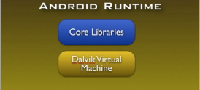
The core libraries are in blue colour
meaning it's is written in Java.
The core libraries contains all the
collection of classes, utilities and IO.
Contd..
Notes:
The installation documentation provided by Android for the SDK is excellent. If you navigate to the website shown on the slide, you will find information about…
Follow the instructions exactly, and you will creating you first Android app in no time.

Slide 10
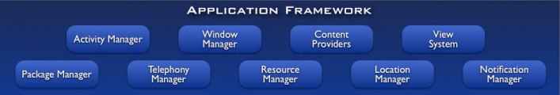
This is all written in Java and the application framework is a toolkit that all applications use.
These applications include native apps as well as third party apps.
So, to conclude all the apps use the same framework and same API's.
Application Framework
Notes:
One refreshing aspect of working with the Android platform is that you can access some of the "goodies" within the device itself. Historically, the inability to access the underlying hardware of a device has been frustrating to mobile developers. Though the Android Java environment still sits between you and the metal, the Android development team brings much of the hardware's capability to the surface. The platform is open source, so you have the flexibility to roll up your sleeves and write some code to accomplish your tasks.

Slide 11
Activity Manager-It manages lifecycles of the activities inside the apps.
Resource Manager-Provides access to all the non-java resources such as graphics etc.
Notification Manager-It controls the app notifications.
Location Manager-It fires alerts when user enters or leaves a specific geo-location.
Package Manager-It is used to retrieve data about installed packages on the device.
Window Manager-Use to create views and layouts.
Telephony Manager-Use to handle settings of the network connection and services.
Contd...
Notes:
The Sensor and Sensor Manager classes contains several constants, which represent different aspects of Android's sensor system, including:

Slide 12

The final layer on top is the applications.
It includes home applications, the contacts application, the browser and the third party apps.
It is the uppermost layer in the android architecture.
All the applications like camera, Google Maps, browser, sms, calendars, contacts are native apps. These apps works with the end user with the help of application framework to operate.
Application Layer

Slide 13
Android is now becoming the best among all the mobile operating systems. Android is used in 170 different mobile models of 27 different mobile companies. It surely takes lot of time for other operating Systems to create such a rapid revolution.
Conclusions

Slide 14
www.theandroid-mania.com/android-architecture/
www.android-arsenal.com
www.developer.android.com
www.javatpoint.com/android-software-stack/
https://source.android.com/devices/
www.c4learn.com/android/android-os-architecture/
www.easytutz.com/android/android-architecture/
www.edureka.co.blog/beginners-guide-android
Resources

